Slide 1
INTRODUCTION TO DATA SCIENCE
Dr. Shital Bhatt
Associate Professor
School of Computational and Data Sciences

Slide 2
Learning objectives
Apprehend the field of Data Science impact and importance in the society
Reflect on its applications, importance and advantages

Slide 3
Contents
Why should study Data Science?
How Does Data Science Impact Organizations?
Application and Competitive Advantage of Data Science in Organization
Importance of Data Science to Society
Road to Become a Data Scientist

Slide 4

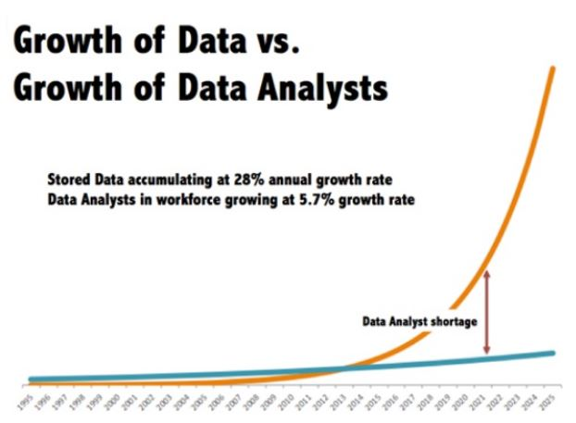
Why we are talking about Data Science?
Source: https://bit.ly/31HBHuQ

Slide 5

What is DATA SCIENCE?
“Data Science is a new term. But in the same sense as Columbus was discovered NEW Continent 1000 years ago.”
- Hector Garcia-Molina
Professor in the Departments
of Computer Science and
Electrical Engineering of
Stanford University

Slide 6
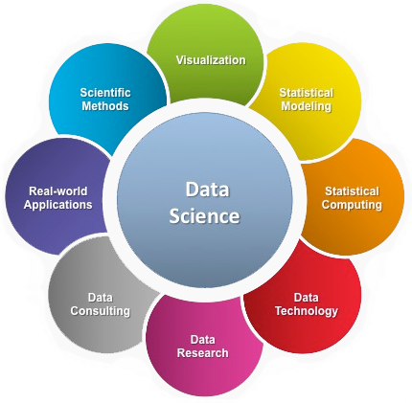
What is DATA SCIENCE?
a multi-disciplinary field that uses scientific methods, processes, algorithms and systems to extract knowledge and insights from structured and unstructured data.
Source: https://bit.ly/30dekJB

Slide 7

What is DATA SCIENCE?
a "concept to unify statistics, data analysis, machine learning and their related methods" in order to "understand and analyze actual phenomena" with data.
employs techniques and theories drawn from many fields within the context of mathematics, statistics, computer science, and information science.
Source: https://bit.ly/2YTRQ3w

Slide 8
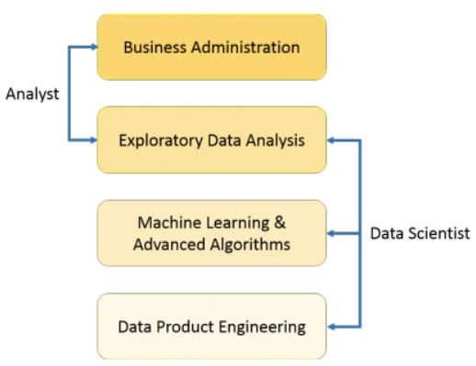
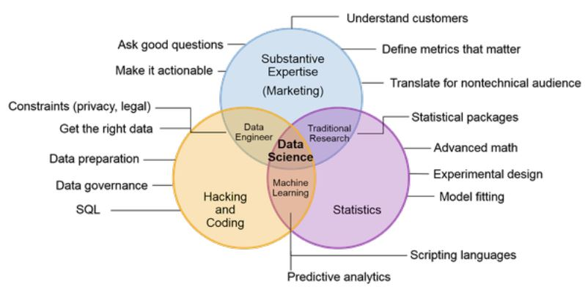
What is DATA SCIENCE?

Slide 9
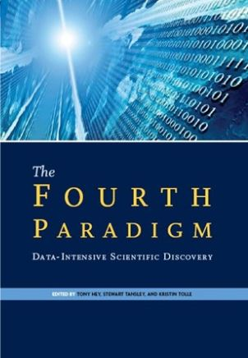
What is DATA SCIENCE?
Fourth Paradigm of Science
Thousand of years
- Empirical
Few hundred of years
- Theoretical
Last fifty years
- Computational
- “Query the world”
Last twenty years
- eScience (Data Science)
- “Download the world”
Notes:
Turing award winner Jim Gray imagined data science as a "fourth paradigm" of science (empirical, theoretical, computational and now data-driven) and asserted that "everything about science is changing because of the impact of information technology" and the data deluge
In 2015, the American Statistical Association identified database management, statistics and machine learning, and distributed and parallel systems as the three emerging foundational professional communities.

Slide 10
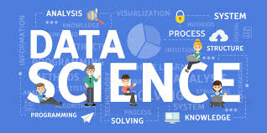
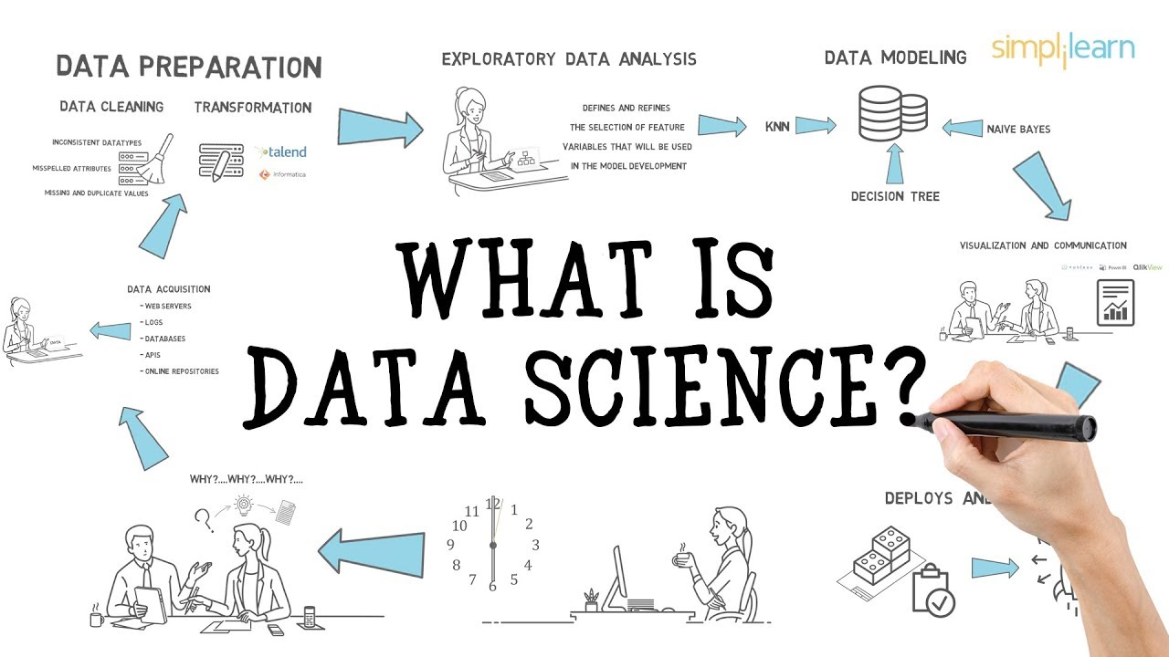
What is DATA SCIENCE?
Data Science and others
Statistics
Big Data Analytics
Business Analytics
Business Intelligence
Data(base) Management
Visualization
Machine Learning
Data Mining
Artificial Intelligence
Predictive Modelling

Slide 11







What is DATA SCIENCE?
Big Data Science Tasks
Facebooks
Amazon
Google
Linkedln
Netflix
Rozetka
Microsoft

Slide 12
What is DATA SCIENCE?
Regular Data Science
Data Analysis
Modelling Statistics
Engineering / Prototyping
Notes:
Data Analysis
What percentage of users back to our site?
Which products usually bought together?
Modelling Statistics
How many cars are going to sell next year?
Which city is better for opening new office?
Engineering / Prototyping
Product to use a prediction model
Visualization of Analytics

Slide 13
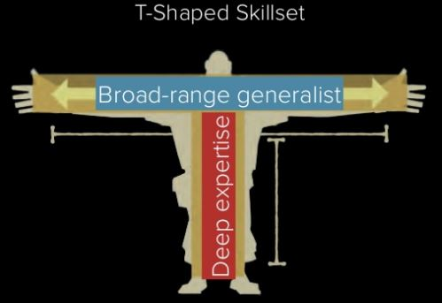
What is DATA SCIENCE?
What do people look for in a data scientist?

Slide 14
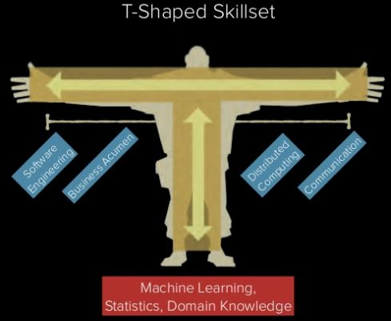
What is DATA SCIENCE?
What do people look for in a data scientist?

Slide 15
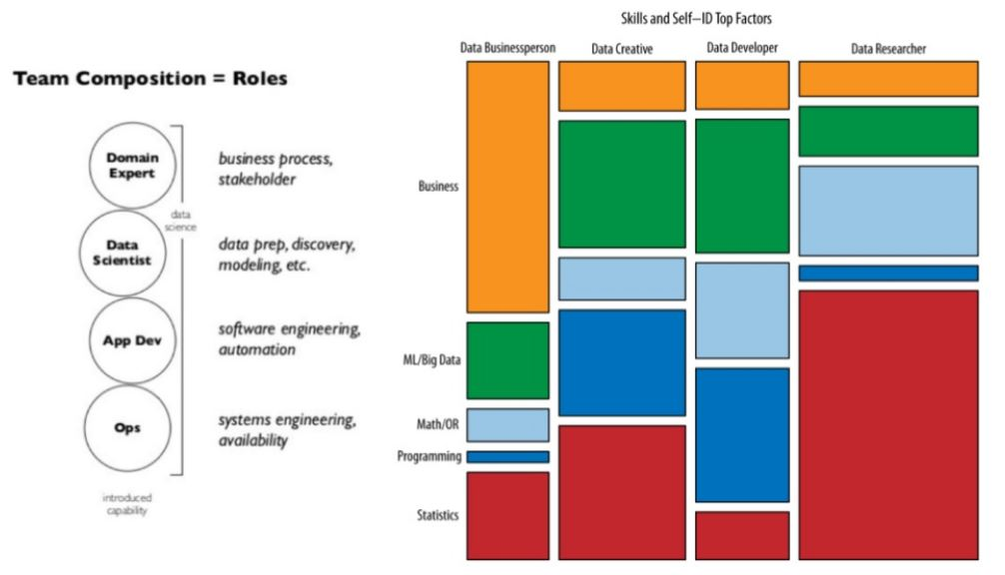
What is DATA SCIENCE?
Data Science Roles

Slide 16
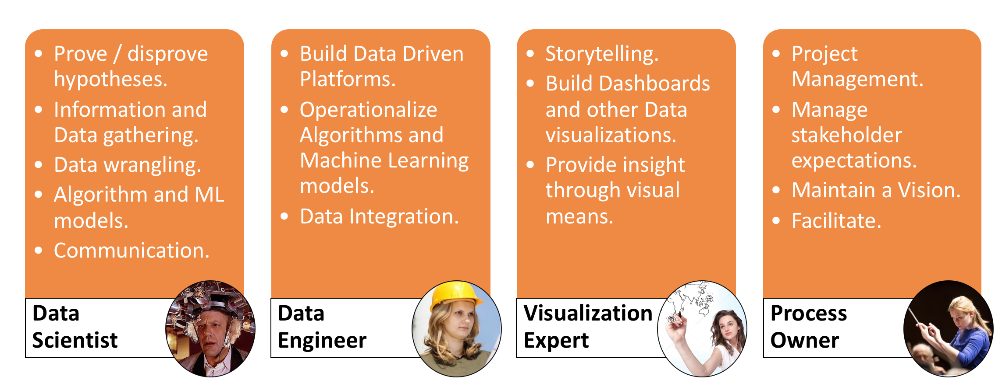
What is DATA SCIENCE?
Roles Required in Data Science Project
Source: https://bit.ly/2z5sYqf

Slide 17
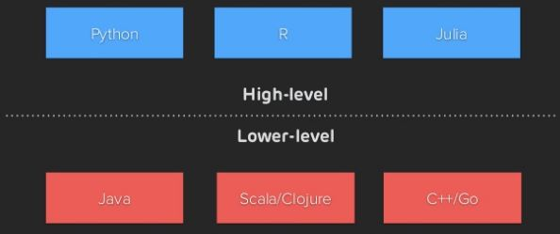
What is DATA SCIENCE?
How to become a data scientist?
Data Scientists need to know how to “CODE”

Slide 18
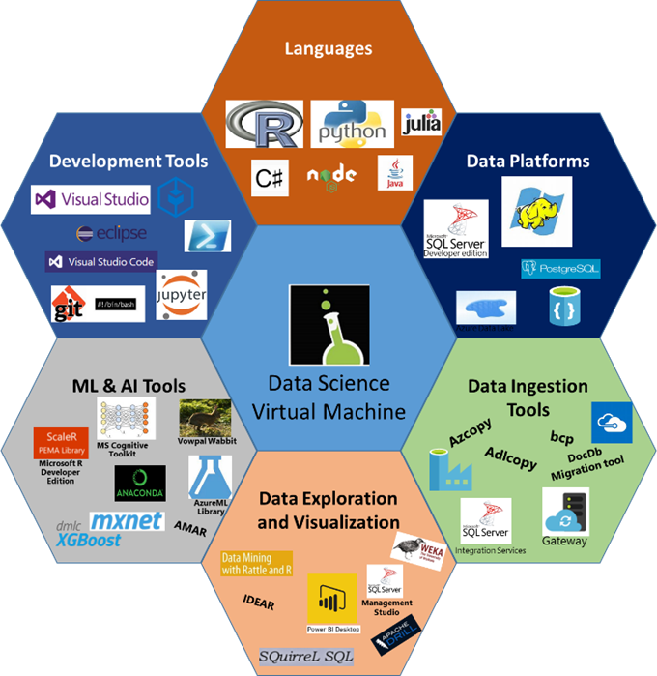
What is DATA SCIENCE?
How to become a data scientist?
Other languages, tools, platforms and visualization

Slide 19
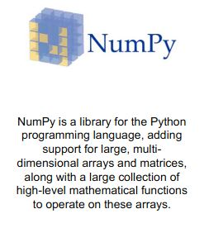
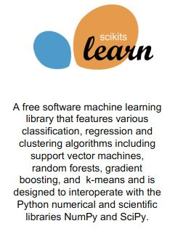
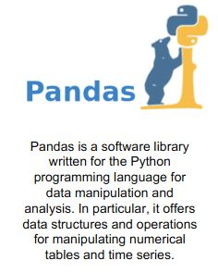
What is DATA SCIENCE?
Learning Data Science with Python - Libraries

Slide 20
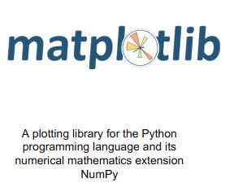
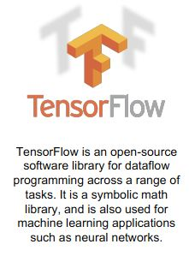

What is DATA SCIENCE?
Learning Data Science with Python - Libraries

Slide 21
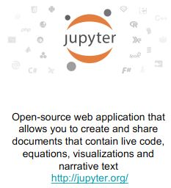

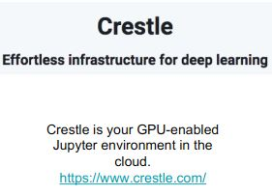
What is DATA SCIENCE?
Learning Data Science with Python - Tools

Slide 22
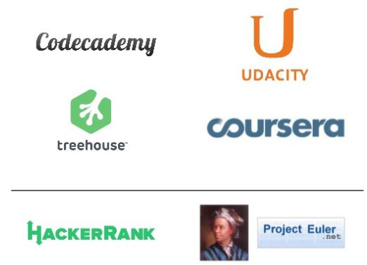
What is DATA SCIENCE?
How to become a data scientist?
Learn to code

Slide 23
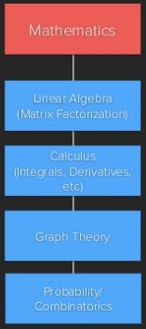
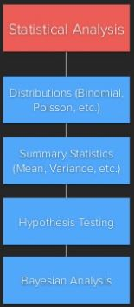
What is DATA SCIENCE?
Data Scientist need to comfortable with:

Slide 24
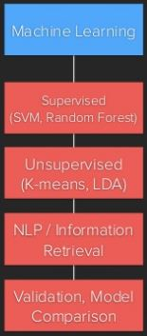
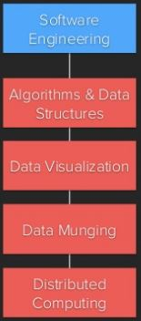
What is DATA SCIENCE?
Data Scientist need to learning machine learning & software engineering

Slide 25
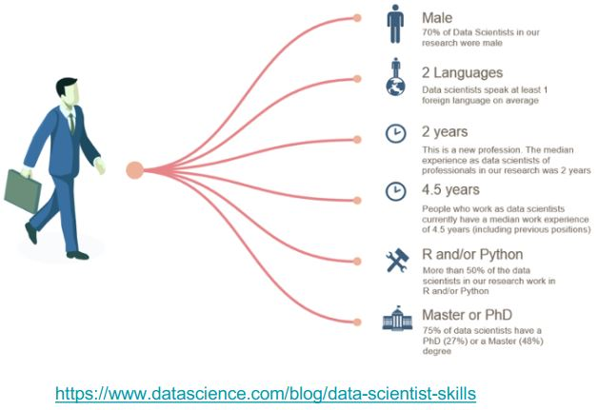
What is DATA SCIENCE?
Who are the Data Scientist?

Slide 26
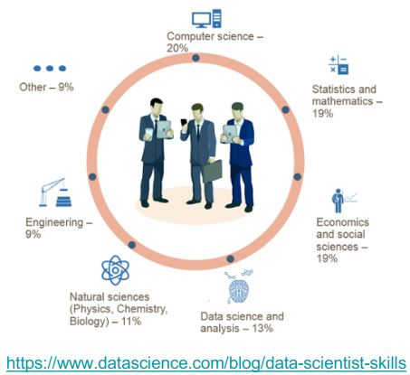
What is DATA SCIENCE?
Who are the Data Scientist?

Slide 27
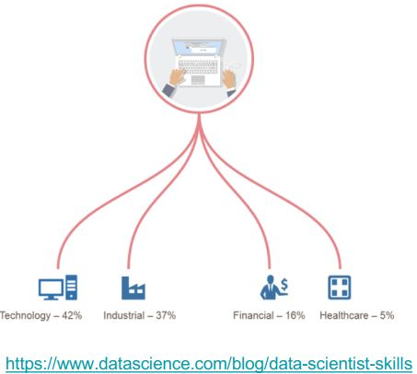
What is DATA SCIENCE?
Who are the Data Scientist?

Slide 28
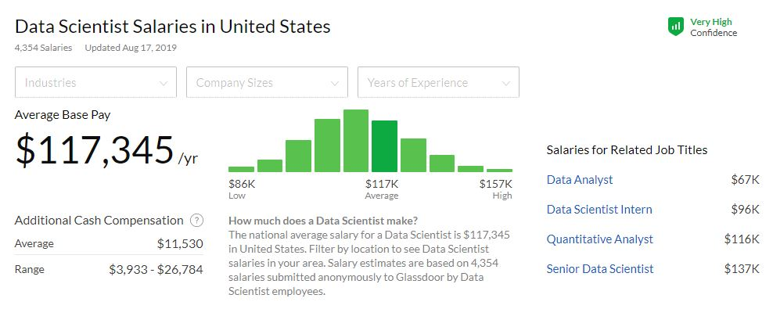
What is DATA SCIENCE?
Notes:
In 2012, when Harvard Business Review called it "The Sexiest Job of the 21st Century", the term "data science" became a buzzword.

Slide 29
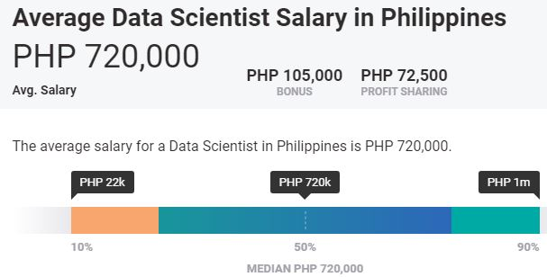
What is DATA SCIENCE?
Notes:
In 2012, when Harvard Business Review called it "The Sexiest Job of the 21st Century", the term "data science" became a buzzword.

Slide 30
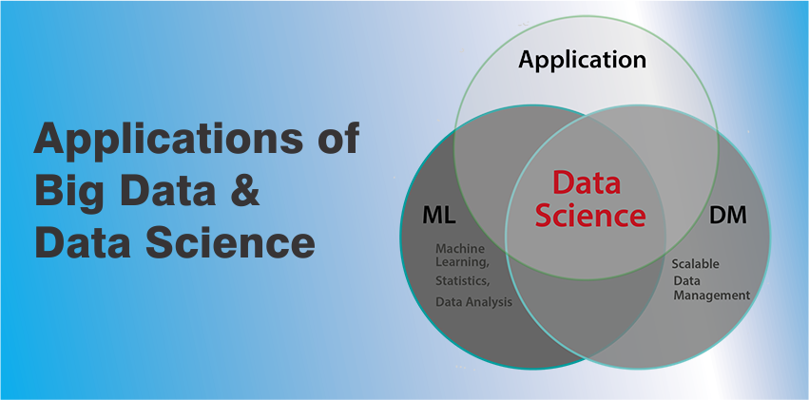
APPLICATION of data science

Slide 31

APPLICATIONs OF DATA SCIENCE
Security

Slide 32

APPLICATIONs OF DATA SCIENCE
Sports

Slide 33
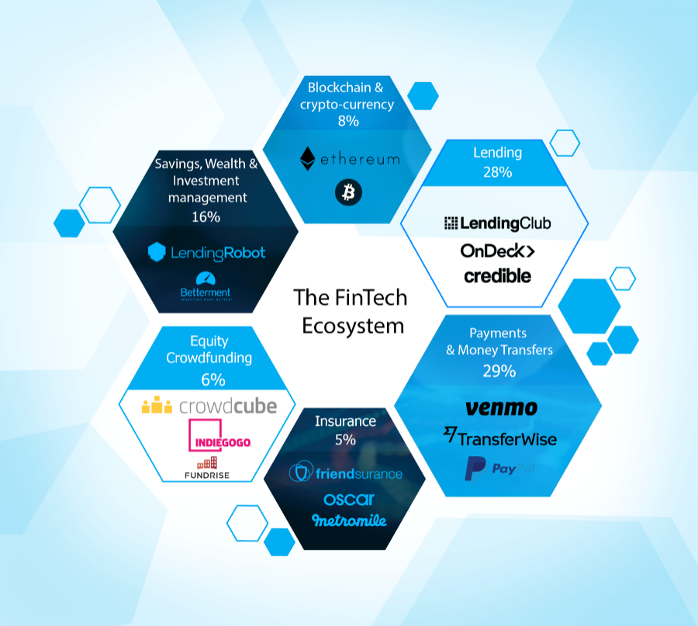
APPLICATIONs OF DATA SCIENCE
Banking and Finance

Slide 34
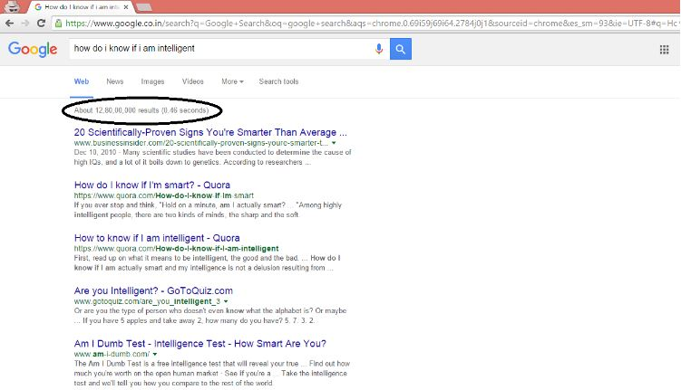
APPLICATIONs OF DATA SCIENCE
Internet Search
Notes:
Search Engines - Google, Yahoo, Bing, Ask, AOL and Duckduckgo
All these search engines (including Google) make use of data science algorithms to deliver the best result for our searched query in fraction of seconds. Considering the fact that, Google processes more than 20 petabytes of data everyday.
Had there been no data science, Google wouldn’t have been the ‘Google’ we know today.

Slide 35
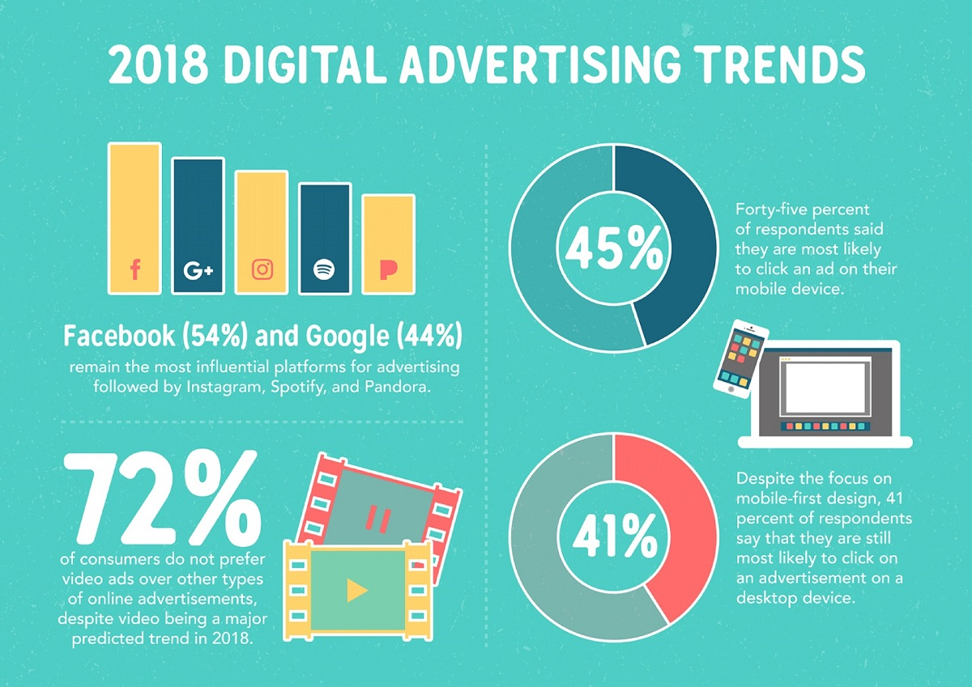
APPLICATIONs OF DATA SCIENCE
Digital Advertisements
Notes:
Starting from the display banners on various websites to the digital bill boards at the airports – almost all of them are decided by using data science algorithms.
This is the reason why digital ads have been able to get a lot higher CTR than traditional advertisements. They can be targeted based on user’s past behaviour. This is the reason why I see ads of analytics trainings while my friend sees ad of apparels in the same place at the same time.

Slide 36
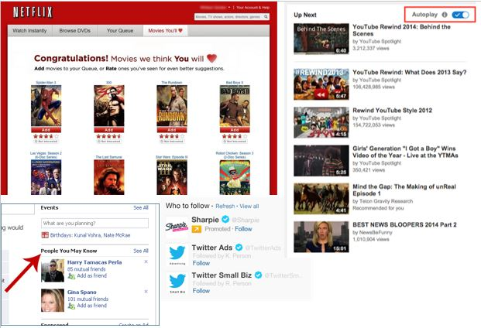
APPLICATIONs OF DATA SCIENCE
Recommender System
Notes:
Internet giants like Amazon, Twitter, Google Play, Netflix, Linkedin, imdb and many more uses this system to improve user experience.
The recommendations are made based on previous search results for a user.

Slide 37
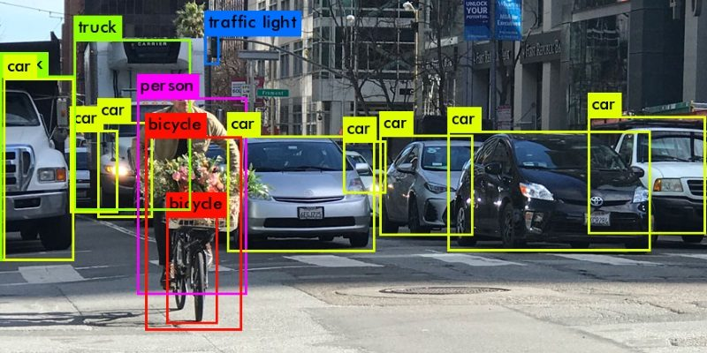
APPLICATIONs OF DATA SCIENCE
Image Processing
Notes:
You upload your image with friends on Facebook and you start getting suggestions to tag your friends.
This automatic tag suggestion feature uses face recognition algorithm.
Similarly, while using whatsapp web, you scan a barcode in your web browser using your mobile phone.
In addition, Google provides you the option to search for images by uploading them.
It uses image recognition and provides related search results.

Slide 38

APPLICATIONs OF DATA SCIENCE
Speech Recognition
Notes:
Some of the best example of speech recognition products are Google Voice, Siri, Cortana etc.
Using speech recognition feature, even if you aren’t in a position to type a message, your life wouldn’t stop.
Simply speak out the message and it will be converted to text.
However, at times, you would realize, speech recognition doesn’t perform accurately.

Slide 39

APPLICATIONs OF DATA SCIENCE
Gaming
Notes:
EA Sports, Zynga, Sony, Nintendo, Activision-Blizzard have led gaming experience to the next level using data science.
Games are now designed using machine learning algorithms which improve / upgrade themselves as the player moves up to a higher level.
In motion gaming also, your opponent (computer) analyzes your previous moves and accordingly shapes up its game.

Slide 40
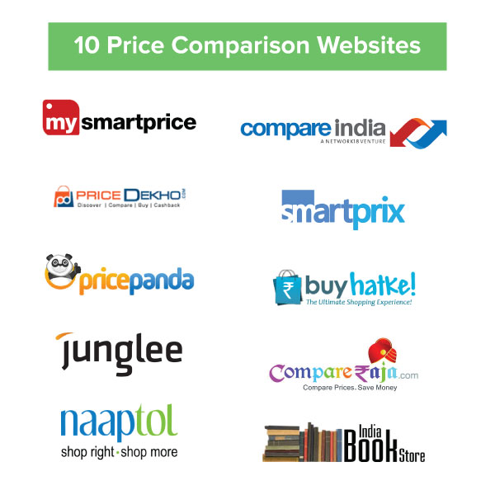
APPLICATIONs OF DATA SCIENCE
Price Comparison Websites
Notes:
At a basic level, these websites are being driven by lots and lots of data which is fetched using APIs and RSS Feeds.
If you have ever used these websites, you would know, the convenience of comparing the price of a product from multiple vendors at one place.
PriceGrabber, PriceRunner, Junglee, Shopzilla, DealTime are some examples of price comparison websites.
Now a days, price comparison website can be found in almost every domain such as technology, hospitality, automobiles, durables, apparels etc.

Slide 41
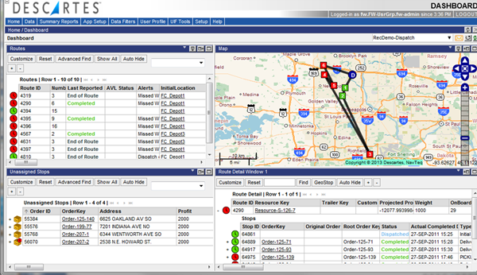
APPLICATIONs OF DATA SCIENCE
Airline Routing Planning
Notes:
Airline Industry across the world is known to bear heavy losses. Except a few airline service providers, companies are struggling to maintain their occupancy ratio and operating profits. With high rise in air fuel prices and need to offer heavy discounts to customers has further made the situation worse. It wasn’t for long when airlines companies started using data science to identify the strategic areas of improvements.
Now using data science, the airline companies can:
Predict flight delay
Decide which class of airplanes to buy
Whether to directly land at the destination, or take a halt in between (For example: A flight can have a direct route from New Delhi to New York. Alternatively, it can also choose to halt in any country.)
Effectively drive customer loyalty programs
Southwest Airlines, Alaska Airlines are among the top companies who’ve embraced data science to bring changes in their way of working.

Slide 42

APPLICATIONs OF DATA SCIENCE
Fraud and Risk Detection
Notes:
One of the first applications of data science originated from Finance discipline.
Companies were fed up of bad debts and losses every year.
However, they had a lot of data which use to get collected during the initial paper work while sanctioning loans.
They decided to bring in data science practices in order to rescue them out of losses.
Over the years, banking companies learned to divide and conquer data via customer profiling, past expenditures and other essential variables to analyze the probabilities of risk and default.
Moreover, it also helped them to push their banking products based on customer’s purchasing power.

Slide 43

APPLICATIONs OF DATA SCIENCE
Delivery Logistics
Notes:
Logistic companies like DHL, FedEx, UPS, Kuhne+Nagel have used data science to improve their operational efficiency.
Using data science, these companies have discovered the best routes to ship, the best suited time to deliver, the best mode of transport to choose thus leading to cost efficiency, and many more to mention.
Further more, the data that these companies generate using the GPS installed, provides them a lots of possibilities to explore using data science.

Slide 44
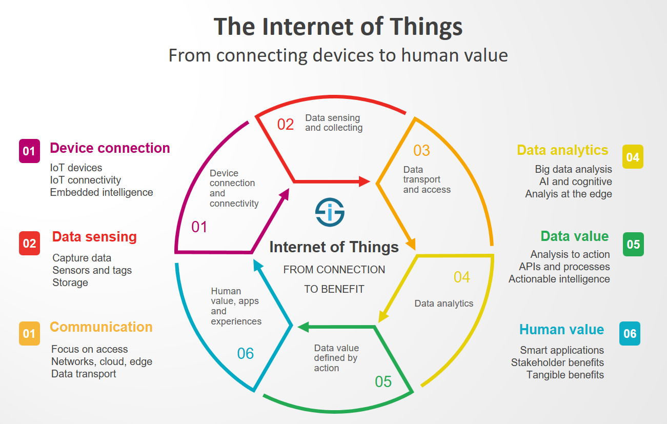
APPLICATIONs OF DATA SCIENCE
Internet of Things (IoT)

Slide 45

APPLICATIONs OF DATA SCIENCE
Health Care
Notes:
Medical Image Analysis
Genetics and Genomics
Drug Development
Virtual assistance for patients and customer support

Slide 46

APPLICATIONs OF DATA SCIENCE
Augmented Reality
Notes:
Data Science and Virtual Reality do have a relationship, considering a VR headset contains computing knowledge, algorithms and data to provide you with the best viewing experience.
A very small step towards this is the high trending game of Pokemon GO.
The ability to walk around things and look at Pokemon on walls, streets, things that aren’t really there.
The creators of this game used the data from Ingress, the last app from the same company, to choose the locations of the Pokemon and gyms.

Slide 47
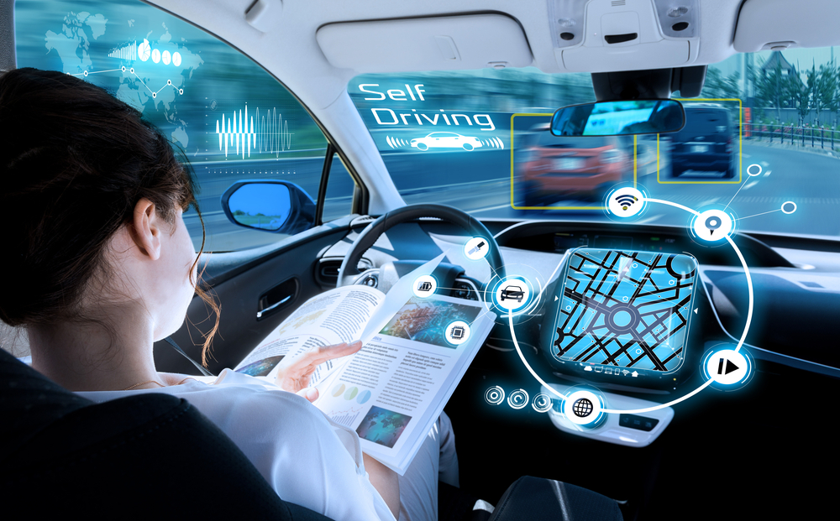
APPLICATIONs OF DATA SCIENCE
Self-Driving Cars

Slide 48

APPLICATIONs OF DATA SCIENCE
Robots
Notes:
Imagine a world, where we are surrounded by robots like these. Will they do any good for us?

Slide 49

IMPACT of data science on society

Slide 50

IMPACT of data science on society
Saving Energy
Notes:
Data scientists are given the opportunity to develop smart data-driven applications that enable the reduce unnecessary energy use,” says Ronald Root, Senior Data Driven Business Developer & Privacy Officer for Eneco.

Slide 51


IMPACT of data science on society
Data-Driven Hospitals

Slide 52

IMPACT of data science on society
A Cleaner Environment
Notes:
Data scientists will develop solutions with our open data, in which man and machine can work together to benefit the people

Slide 53
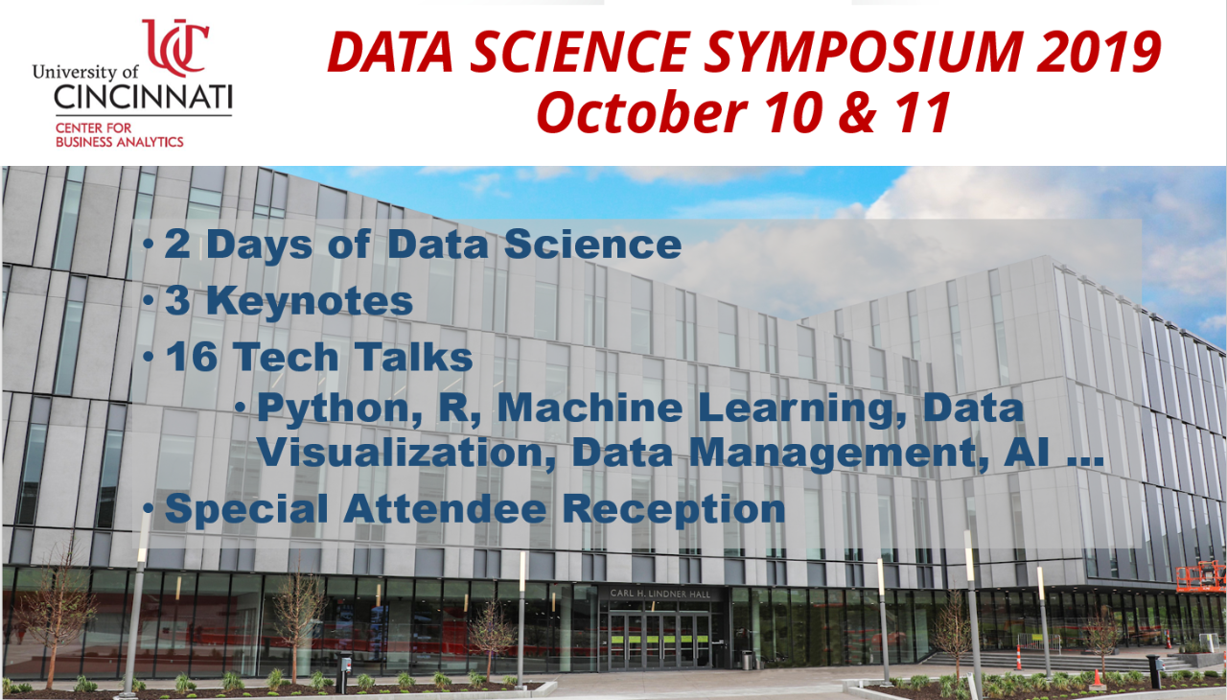
IMPACT of data science on society
Volunteer with a socially-oriented data science program/organization
Notes:
a data-science organization that is solely focused on social good and offers various opportunities for volunteering, whether it’s through mentoring or using your data science skills to help solve a social problem

Slide 54
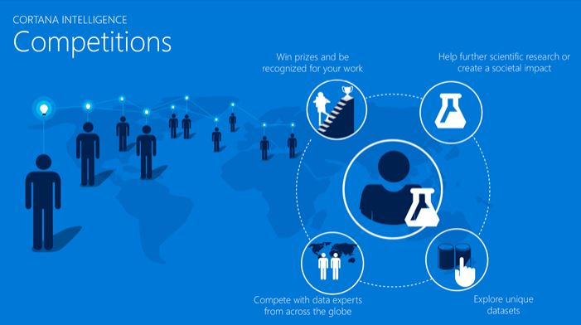
IMPACT of data science on society
Contribute via competitions
Notes:
A newer, socially-focused competition platform, DrivenData partners with various organizations. These organizations are typically non-profit, focused on difficult social problems with real-world impact.

Slide 55
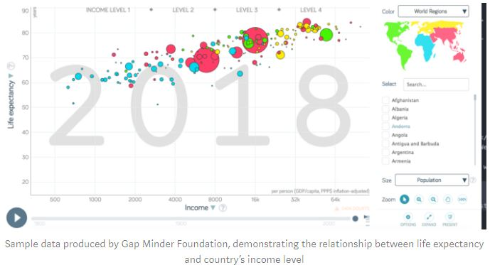
IMPACT of data science on society
Consider solutions to real-world problems that you encounter
Notes:
A resourceful data scientist can identify and work to solve social good problems on their own, with the data available to them.
A great resource for data is the Gap Minder Foundation which provides statistics to understand global trends.
Rather than obscuring statistics with emotions or drama, Gap Minder emphasizes objectivity to promote genuine understanding of our world so that we can work better to make it better.

Slide 56

IMPACT of data science on society
Be thoughtful in professional work
Notes:
Data science positions exist and continue to emerge across all sectors, from the private to the public and non-profit sectors.
There are so many opportunities to make a meaningful social impact in your professional endeavors.
Within the private sector, there are certainly companies that develop innovative solutions to greater societal problems.
Data science work is also available for organizations that are oriented towards serving the public good.
Governments are beginning to recognize the importance of data in understanding their citizenry, particularly its use in implementing effective, evidence-based interventions and policies.

Slide 57
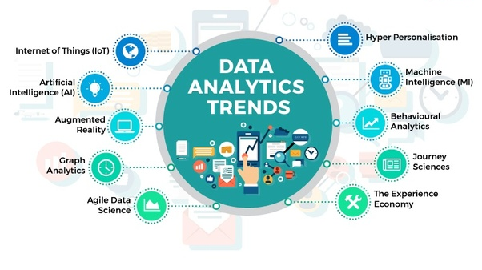
IMPORTANCE of data science

Slide 58
Importance of data science
Data science helps brands to understand their customers in a much enhanced and empowered manner.
2. It allows brands to communicate their story in such
a engaging and powerful manner.
3. Big Data is a new field that is constantly growing
and evolving.
Notes:
Customers are the soul and base of any brand and have a great role to play in their success and failure. With the use of data science, brands can connect with their customers in a personalized manner, thereby ensuring better brand power and engagement.
When brands and companies utilize this data in a comprehensive manner, they can share their story with their target audience, thereby creating better brand connect. After all, nothing connects with consumers like an effective and powerful story, that can inculcate all human emotions.
With so many tools being developed, almost on a regular basis, big data is helping brands and organisations to solve complex problems in IT, human resource, and resource management in an effective and strategic manner. This means effective use of resources, both material and non-material.

Slide 59
Importance of data science
4. Its findings and results can be applied to almost any
sector like travel, healthcare and education among
others.
5. Data science is accessible to almost all sectors.
Notes:
4. Understanding the implications of data science can go a long way in helping sectors to analyze their challenges and address them in an effective fashion.
5. There is a large amount of data available in the world today and utilizing them in an proper manner can spell success and failure for brands and organizations. Utilizing data in a proper manner will hold the key for achieving goals for brands, especially in the coming times.

Slide 60
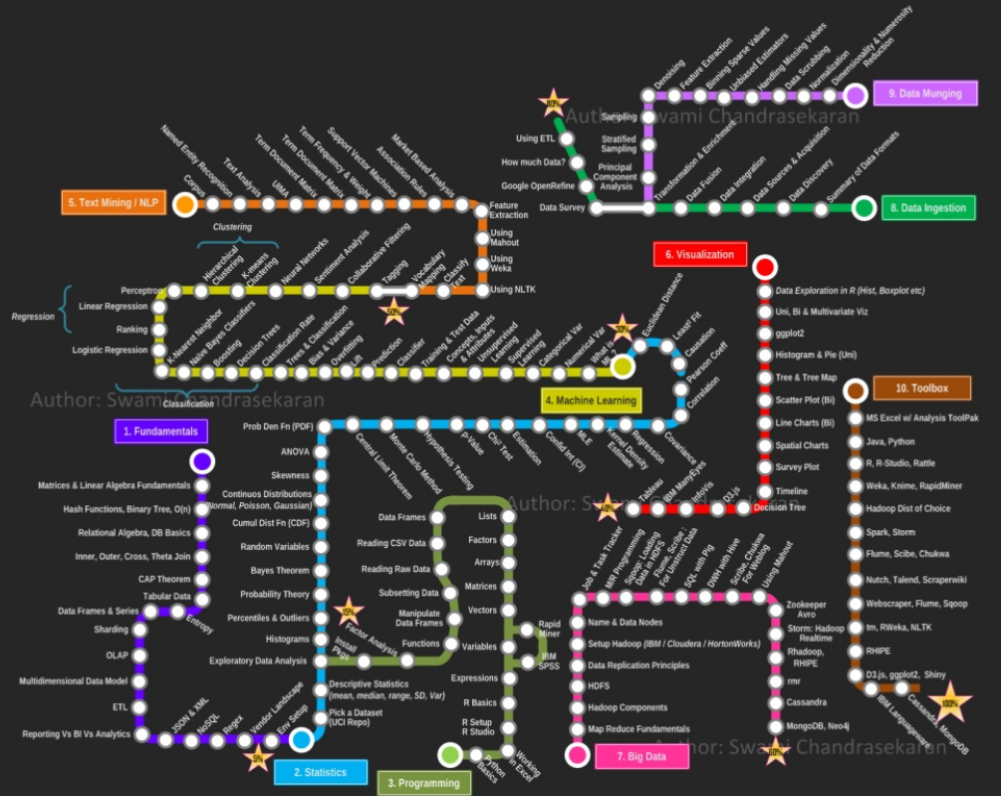
Road to become a Data Scientist
Notes:
Learning data science can be really hard.

Slide 61
Data science terminology Application Programming Interface (API) Collection of software routines, protocols, and tools which provide a programmer with all the building blocks for developing an application program for a specific platform (environment). An API also provides an interface that allows a program to communicate with other programs, running in the same environment. (BusinessDictionary.com) Artificial Intelligence (AI) Artificial intelligence is a field of computer science dedicated to solving cognitive problems commonly associated with human intelligence such as learning, problem solving, visual perception and speech and pattern recognition. Artificial Intelligence System A technological system that uses a model to make inferences to generate output, including predictions, recommendations or decisions. Data Science Data Science is an interdisciplinary field that uses scientific methods and algorithms to extract information and insights from diverse data types. It combines domain expertise, programming skills and knowledge of mathematics and statistics to solve analytically complex problems.

Slide 62
Deep Learning Subset of machine learning that imitates the workings of the human brain in processing data and improves performance. Typically, a multi-level algorithm that gradually identifies things at higher levels of abstraction. For example, the first level may identify certain lines, then the next level identifies combinations of lines as shapes, and then the next level identifies combinations of shapes as specific objects. Deep learning is popular for image classification. (www.datascienceglossary.org) Event An event in the Unified Modeling Language (UML) is a notable occurrence at a particular point in time. Events can, but do not necessarily, cause state transitions from one state to another in state machines represented. (wikipedia.org) Latent variables Latent variables are variables that are not directly observed but are rather inferred (through a mathematical model) from other variables that are observed (directly measured). Mathematical models that aim to explain observed variables in terms of latent variables are called latent variable models. (datascienceglossary.org) Machine Learning (ML) "Machine learning is the science of getting computers to automatically learn from experience instead of relying on explicitly programmed rules, and generalize the acquired knowledge to new settings." United Nations Economic Commission for Europe's Machine Learning Team (2018 report) The use of machine learning in official statistics. In essence, Machine Learning automates analytical model building through optimization algorithms and parameters that can be modified and fine-tuned.

Slide 63
Python A programming language available since 1994 that is popular with people doing data science. Python is noted for ease of use among beginners, and great power when used by advanced users, especially when taking advantage of specialized libraries such as those designed for machine learning and graph generation. (datascienceglossary.org) R An open-source programming language and environment for statistical computing and graph generation available for Linux, Windows, and Mac. (datascienceglossary.org) Reinforcement Learning (RL) Reinforcement Learning (RL) is a sub-field of Machine Learning involving a controller (termed an agent) capable of taking actions in the form of decisions within a system. After each decision is made by the controller, the system evolves to a new state and the controller receives a measure of utility. By trial and error, the controller learns from its experience to optimize an action selection strategy that maximizes the expected cumulative utility within the system. RL is typically used to solve problems that can be modelled as sequential decision processes.

Slide 64
Semantic Semantics can address meaning at the levels of words, phrases, sentences, or larger units of discourse. In machine learning, semantic analysis of a corpus is the task of building structures that approximate concepts from a large set of documents. It generally does not involve prior semantic understanding of the documents. (wikipedia.org) Stochastic optimization Stochastic optimization methods are optimization methods that generate and use random variables. For stochastic problems, the random variables appear in the formulation of the optimization problem itself, which involves random objective functions or random constraints. Stochastic optimization methods also include methods with random iterates. (wikipedia.org) Supervised Learning A type of machine learning algorithm in which a system is taught via examples. For instance, a supervised learning algorithm can be taught to classify input into specific, known classes. The classic example is sorting email into spam versus non-spam. (datascienceglossary.org) Unsupervised Learning A class of machine learning algorithms designed to identify groupings of data without knowing in advance what the groups will be. (datascienceglossary.org) Web scraping Web scraping is a term for various methods used to collect information from across the Internet. Generally, this is one with software that simulates human Web surfing to collect specified bits of information from different websites. (techopedia)

